Slide 1




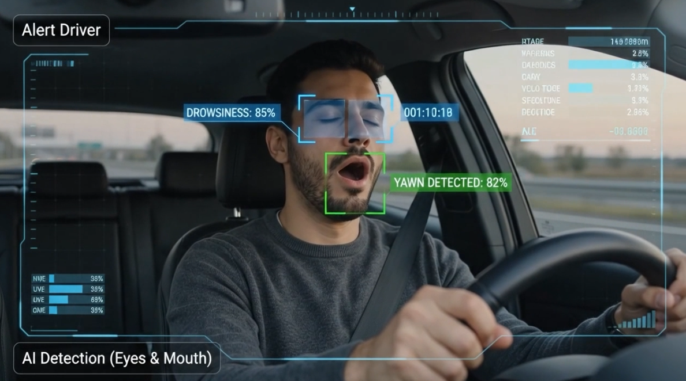






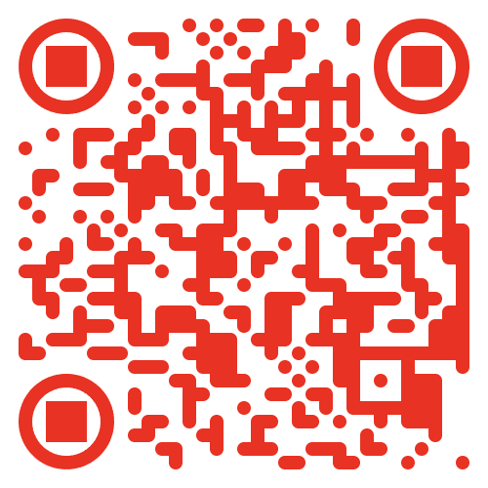









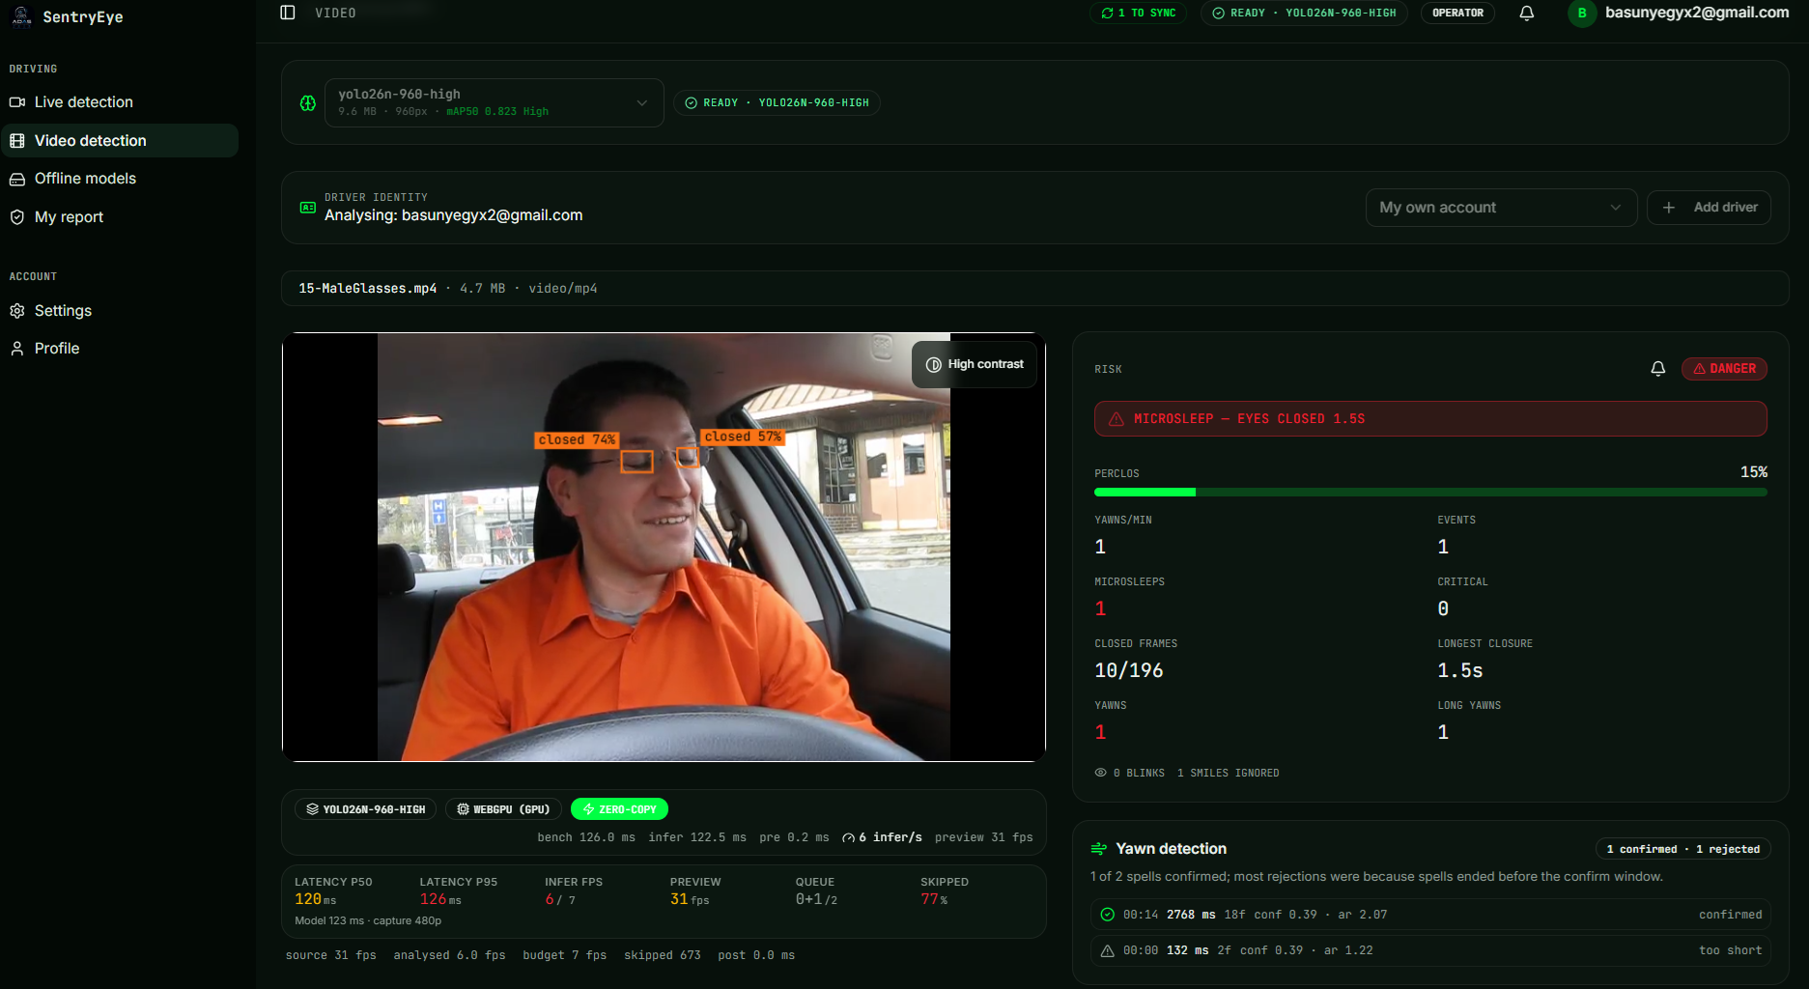

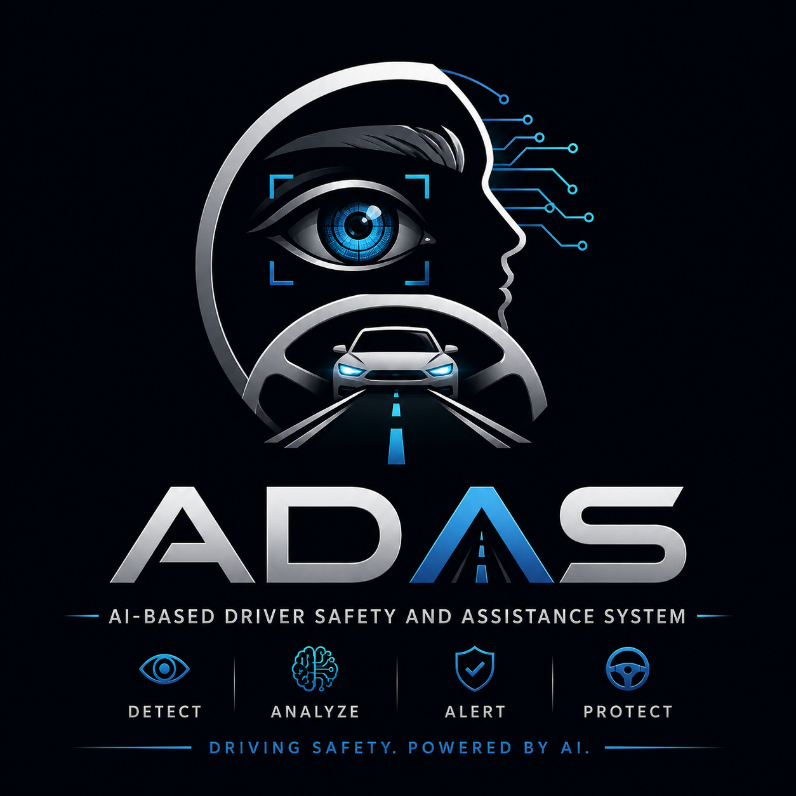
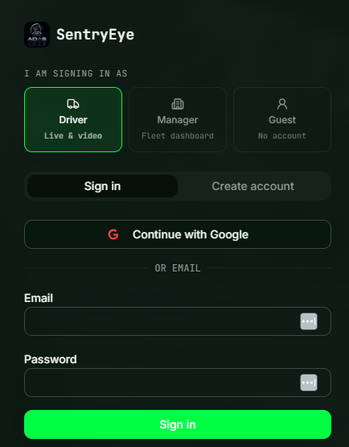









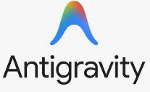


Presented by:
Mohamed Mostafa El-Basyouni (Team Leader)
Michael Magdy Amin Sidhom
Ali Ibrahim Ahmed Othman
Karim Mustafa Ali Ibrahim
Mohamed Osama Bahnasy Abdel Halim
AI-Based Driver Safety and Assistance System(ADAS)
Under Supervision of:
[ DR. Kamel Elhadad ]
SentryEye
RESULTS
mAP@50
mAP@50
AI-BASED DRIVER SAFETY AND ASSISTANCE SYSTEM
86.75%
86.75%
REAL-TIME DROWSINESS DETECTION.
SMARTER ALERTS. SAFER ROADS.
Precision
Recall
90.23%
88.38%
A fully on-device, browser-native AI system that detects driver fatigue through eye closure, yawning, PERCLOS, and micro-event analysis.
F1-Score
Inference Speed
89.23%
97.2 FPS
ABSTRACT
SYSTEM OVERVIEW
QR CODE
SentryEye is an on-device AI driver safety system that detects eye closure and yawning in real time. Using YOLO26n, PERCLOS, and micro-event analysis, the system interprets fatigue levels and delivers visual and audio alerts directly in the browser without uploading video.
Camera / Video Input
Frame Processing
YOLO26n Inference
PERCLOS + Micro-events
Debounced Alert State
HUD + audio alert + safety report follow the debounced state machine. Every node, arrow, and label is editable.
https://sharp-gaze-platform.lovable.app
https://dashboard-grad-project.vercel.app
METHODOLOGY
Conclusion
1. Dataset Construction → Data Cleaning
& Label Collection
2. Production Pipeline → Browser Deployment
SentryEye demonstrates that real-time driver drowsiness detection can be deployed directly in the browser without transmitting video to a remote server. Visual detection, PERCLOS, and real-time alerts provide a practical foundation for privacy-preserving driver safety.
Dataset Construction · Data Cleaning & Label Collection · Model Training · Cross-Model Evaluation
Model Selection · ONNX Export · WebGPU / WASM Deployment · Temporal Fatigue Analysis · Real-Time Alerting
Production model: YOLO26n at 480px and 960px, exported to ONNX and executed in-browser through WebGPU / WASM.
Only the replaceable icons are decorative; the shapes, arrows, and text all remain editable.
Our Platform
DATASET
Aim of the work
50,654
To develop a real-time, camera-based driver drowsiness detection system that combines reliable computer vision with temporal fatigue analysis and privacy-preserving browser deployment.
IMAGES · 68,292 ANNOTATED INSTANCES
39,627
5,438
5,589
TRAIN
VAL
TEST
3 CLASSES
closed_eye
open_eye
yawning
✅
THE PROBLEM
✅
✅
Driver fatigue is a leading cause of road traffic collisions. Prolonged eye closure and yawning are visible warning signs — but existing detection datasets are too fragmented and inconsistently annotated to build a reliable detector directly.
Augmentation: HSV jitter, rotation, shear, translation, random erasing (moderate + worst-case tiers).
Mosaic / mixup / copy-paste deliberately disabled.
Offline models
Future Work
OUR SOLUTION
Save a detection model to device once. Live and video detection then start instantly and keep working with no internet connection.
Learned temporal modeling (RNN / LSTM) for blink & yawn duration
Multi-task learning — facial landmarks + gaze
Multi-camera support
Context-aware driver personalization
SentryEye detects three visual states per frame — closed eye, open eye, yawning — then aggregates them into a rolling PERCLOS score and a debounced SAFE / WARNING / CRITICAL alert, so a single misdetection never triggers a false alarm.
The Privacy
KEY FEATURES
Driver Report
Manger report
Offline-capable — works fully in-browser without needing constant internet connection
Lightweight, on-device deployment — YOLO11n model compressed below 10MB, runs via WebGPU with no server dependency
AI MODELS
The driver will only be able to view his reports status so that he can manage his status to avoid getting fired
Managers can view all drivers' aggregated metrics and multi-month performance histories—without live camera feeds—ensuring privacy and informed decision-making
USED TOOLS
4 architecture families compared under one protocol:
YOLO26 (n / s) · YOLOv11 (n / m) · RF-DETR (Nano / Small) · Faster R-CNN (custom)
21 trained configurations
950 epochs · 277.6 GPU-hours (RTX 2000 Ada)
Production model: YOLO26n – 480px & 960px + ONNX + WebGPU / WASM

